Slide 1
Microsoft Azure Fundamentals
Module 2, Section 1
Dr. Tóth Ádám
toth.adam@inf.unideb.hu

Slide 2
Microsoft Azure
Azure: Azure is a continually expanding set of cloud services that help you meet current and future business challenges.
What Azure offers:
Be ready for the future
Build on your terms
Operate hybrid seamlessly
Trust your cloud

Slide 3
Microsoft Azure
Azure provides more than 100 services that enable you to do everything from running your existing applications on virtual machines
Many teams start exploring the cloud by moving their existing applications to virtual machines (VMs) that run in Azure
For example, Azure provides artificial intelligence (AI) and machine-learning (ML) services that can naturally communicate with your users through vision, hearing, and speech

Slide 4
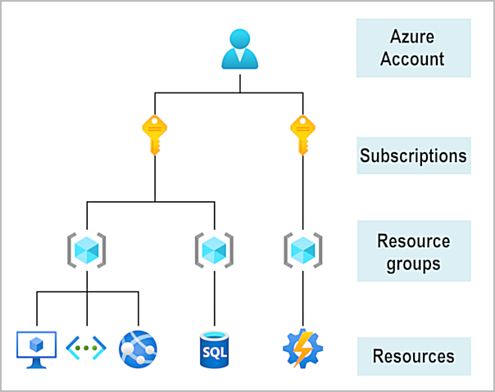
Azure account
Azure subscription is needed.
© Copyright Microsoft Corporation. All rights reserved.

Slide 5
Azure free acount
Free access to popular Azure products for 12 months
A credit to spend for the first 30 days
Access to more than 25 products that are always free

Slide 6
Azure free student acount
Free access to certain Azure services for 12 months.
A credit to use in the first 12 months.
Free access to certain software developer tools.

Slide 7
Azure architectural components
Notes:
https://learn.microsoft.com/training/modules/describe-core-architectural-components-of-azure/1-introduction

Slide 8
Azure physical infrastructure
Datacenters: Azure has datacenters around the world. However, these individual datacenters aren’t directly accessible.
Regions: A region is a geographical area on the planet that contains at least one, but potentially multiple datacenters that are nearby and networked together with a low-latency network.
Availability Zones: Availability zones are physically separate datacenters within an Azure region. Each availability zone is made up of one or more datacenters equipped with independent power, cooling, and networking.
Region pairs: Most Azure regions are paired with another region within the same geography at least 300 miles away
Sovereign Regions: Sovereign regions are instances of Azure that are isolated from the main instance of Azure

Slide 9
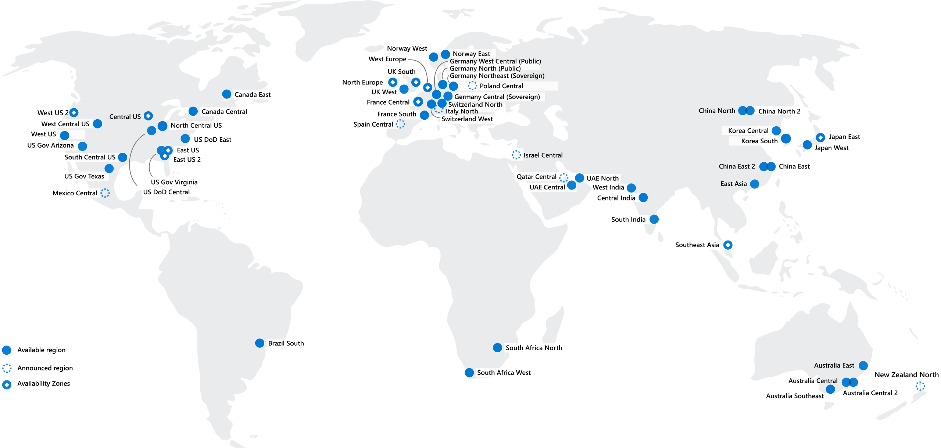
Regions
Azure offers more global regions than any other cloud provider with 60-plus regions representing over 140 countries
Regions are made up of one or more datacenters in close proximity.
They provide flexibility and scale to reduce customer latency.
Regions preserve data residency with a comprehensive compliance offering.
Notes:
https://learn.microsoft.com/training/modules/describe-core-architectural-components-of-azure/5-describe-azure-physical-infrastructure
A region represents a collection of datacenters.
They provide flexibility and scale.
Regions preserve data residency.
You can select regions close to your users.
Be aware of region deployment availability.
There are global services that are region independent.
A list of regions and their locations is available at https://azure.microsoft.com/explore/global-infrastructure/data-residency/#overview

Slide 10
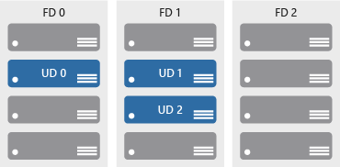

Availability zones
Provide protection against downtime due to datacenter failure.
Physically separate datacenters within the same region.
Each datacenter is equipped with independent power, cooling, and networking.
Connected through private fiber-optic networks.
Azure Region
Availability Zone 1
Availability Zone 2
Availability Zone 3
Notes:
https://learn.microsoft.com/training/modules/describe-core-architectural-components-of-azure/5-describe-azure-physical-infrastructure
Physically separate locations within an Azure region.
Takes availability sets to the next level
Includes one or more datacenters, equipped with independent power, cooling, and networking.
Acts as an isolation boundary.
If one availability zone goes down, the other continues working.
More details about Availability Zones in Azure are available at https://learn.microsoft.com/azure/reliability/availability-zones-overview

Slide 11
Availability zones
Availability zones are primarily for VMs, managed disks, load balancers, and SQL databases.
Azure services that support availability zones fall into three categories:
Zonal services: You pin the resource to a specific zone (for example, VMs, managed disks, IP addresses).
Zone-redundant services: The platform replicates automatically across zones (for example, zone-redundant storage, SQL Database).
Non-regional services: Services are always available from Azure geographies and are resilient to zone-wide outages as well as region-wide outages

Slide 12
Region pairs
At least 300 miles of separation between region pairs.
Automatic replication for some services.
Prioritized region recovery in the event of outage.
Updates are rolled out sequentially to minimize downtime.
Web link: https://aka.ms/PairedRegions
Region
North Central US​
East US​
West US 2​
US East 2​
Canada Central​
North Europe​
UK West​
Germany Central​
South East Asia​
East China​
Japan East​
Australia Southeast​
India South​
Brazil South (Primary)​
Region
South Central US​
West US​
West Central US​
Central US​
Canada East​
West Europe​
UK South​
Germany Northeast​
East Asia​
North China​
Japan West​
Australia East​
India Central​
South Central US ​

Slide 13
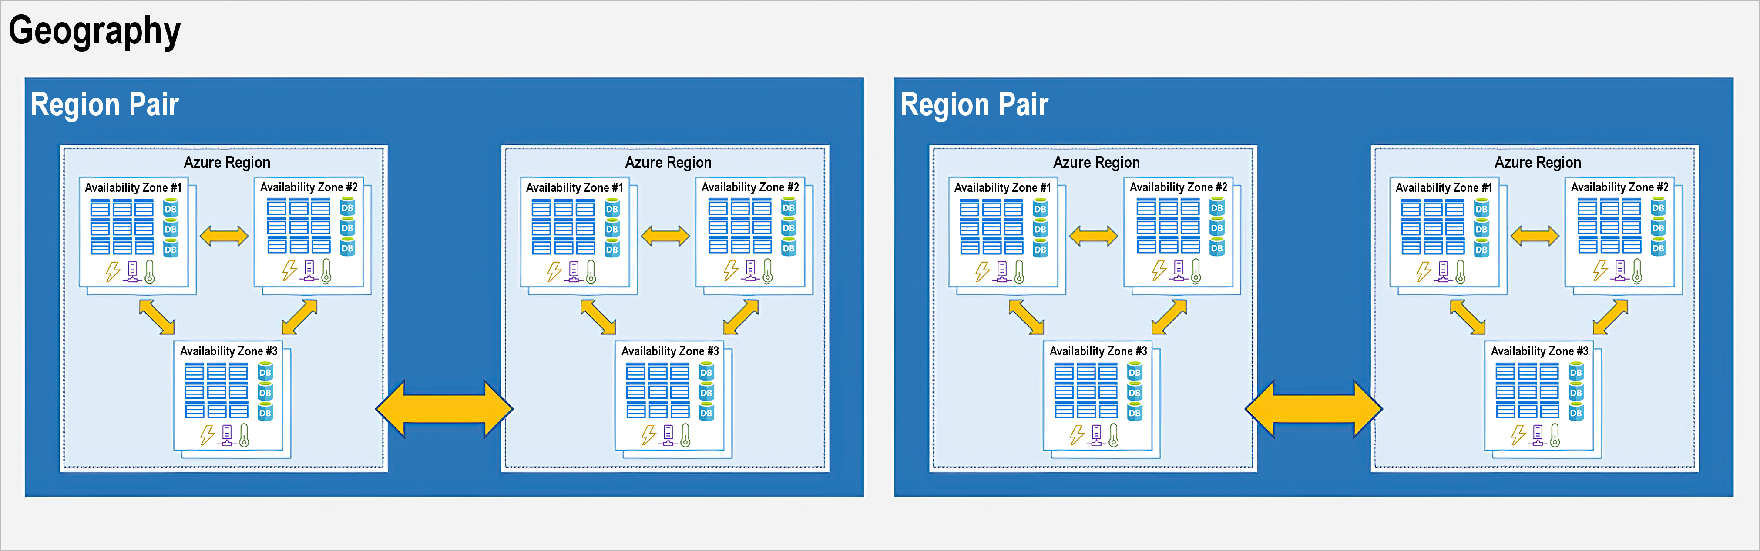
Azure region pairs
Examples of region pairs in Azure are West US paired with East US and SouthEast Asia paired with East Asia

Slide 14
Azure region pairs
The pair of regions is directly connected and far enough apart to be isolated from regional disasters.
Additional advantages of region pairs:
If an extensive Azure outage occurs, one region out of every pair is prioritized to make sure at least one is restored as quickly as possible for applications hosted in that region pair.
Planned Azure updates are rolled out to paired regions one region at a time to minimize downtime and risk of application outage.
Data continues to reside within the same geography as its pair (except for Brazil South) for tax- and law-enforcement jurisdiction purposes.

Slide 15
Azure sovereign regions (US government services)
Meets the security and compliance needs of US federal agencies, state and local governments, and their solution providers.
Azure government:
Separate instance of Azure.
Physically isolated from non-US government deployments.
Accessible only to screened, authorized personnel.
Notes:
https://learn.microsoft.com/training/modules/describe-core-architectural-components-of-azure/5-describe-azure-physical-infrastructure
Azure Government - https://azure.microsoft.com/en-us/global-infrastructure/government/

Slide 16
Azure sovereign regions (Azure China)
Microsoft is China’s first foreign public cloud service provider, in compliance with government regulations.
Azure China features:
Physically separated instance of Azure cloud services operated by 21Vianet.
All data stays within China to ensure compliance.
Notes:
https://learn.microsoft.com/training/modules/describe-core-architectural-components-of-azure/5-describe-azure-physical-infrastructure
Azure China 21Vianet - https://learn.microsoft.com/azure/china/
China East, China North, and more: These regions are available through a unique partnership between Microsoft and 21Vianet, whereby Microsoft doesn't directly maintain the datacenters.

Slide 17
Azure management infrastructure
Azure management groups: If you have many subscriptions, you might need a way to efficiently manage access, policies, and compliance for those subscriptions. Azure management groups provide a level of scope above subscriptions.
Azure subscriptions: In Azure, subscriptions are a unit of management, billing, and scale.
Azure resource groups: Resource groups are simply groupings of resources.
Azure resources: A resource is the basic building block of Azure. Anything you create, provision, deploy, etc. is a resource.

Slide 18






Azure resources
Azure resources are components like storage, virtual machines, and networks that are available to build cloud solutions.
Virtual machines
Storage accounts
Virtual networks
App services
SQL databases
Functions
Notes:
https://learn.microsoft.com/training/modules/describe-core-architectural-components-of-azure/6-describe-azure-management-infrastructure

Slide 19



Resource groups
A resource group is a container you use to manage and aggregate resources in a single unit.
Resources can exist in only one resource group.
Resources can exist in different regions.
Resources can be moved to different resource groups.
Applications can utilize multiple resource groups.
Resource groups (web plus DB, VM, storage) in one group
OR
Web and DB resource group
Virtual machine resource group
Storage resource group
Notes:
https://learn.microsoft.com/training/modules/describe-core-architectural-components-of-azure/6-describe-azure-management-infrastructure
Containers for multiple resources that share the same life cycle.
Aggregates resources into a single manageable unit.
Every Azure resource must exist in one (and only one) resource group.
Secure at the resource group (or resource) level―using role-based access control (RBAC).

Slide 20
Life cycle
If you delete a resource group, all resources contained within it are also deleted.
Resource groups make it easy to remove a set of resources all at once.

Slide 21
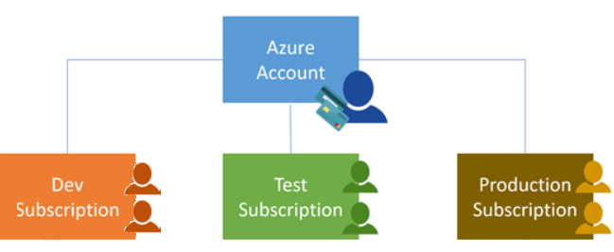
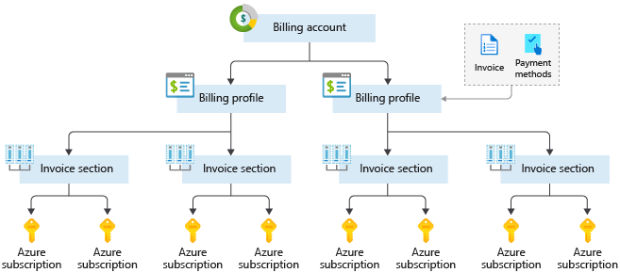
Azure subscriptions
An Azure subscription provides you with authenticated and authorized access to Azure accounts.
Billing boundary: Generate separate billing reports and invoices for each subscription.
Access control boundary: Manage and control access to the resources that users can provision with specific subscriptions.
Notes:
https://learn.microsoft.com/training/modules/describe-core-architectural-components-of-azure/6-describe-azure-management-infrastructure
An account can have one or multiple subscriptions.
Azure subscription offers: https://azure.microsoft.com/en-us/support/legal/offer-details/

Slide 22
Create additional Azure subscriptions
Environments
Organizational structures
Billing

Slide 23
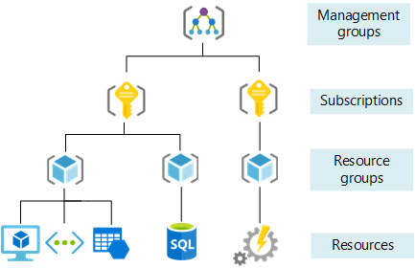
Management groups
Management groups can include multiple Azure subscriptions.
Subscriptions inherit conditions applied to the management group.
10,000 management groups can be supported in a single directory.
A management group tree can support up to six levels of depth.
Notes:
https://learn.microsoft.com/training/modules/describe-core-architectural-components-of-azure/6-describe-azure-management-infrastructure
Management groups can include multiple Azure subscriptions.
Subscriptions inherit conditions applied to the management group.
10,000 management groups can be supported in a single directory.
A management group tree can support up to six levels of depth.
Management groups: https://learn.microsoft.com/azure/governance/management-groups/

Slide 24
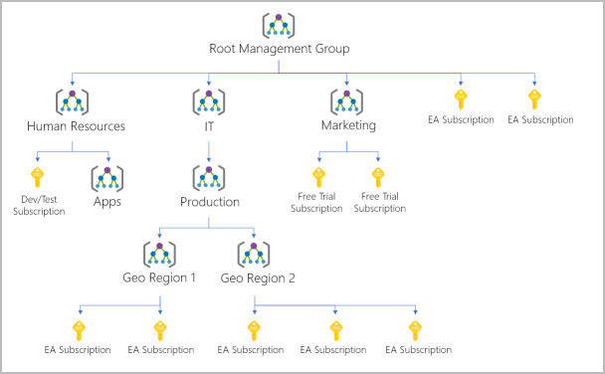
Hierarchy of management groups and subscriptions
You can build a flexible structure of management groups and subscriptions to organize your resources into a hierarchy for unified policy and access management.

Slide 25
Knowledge check
What Microsoft Azure object contains multiple datacenters that are connected by a low-latency network?
A geography
A region
An availability set
A pair

Slide 26
Knowledge check
2. Availability zones allow customers to run mission-critical applications with what benefits?
Select all that apply.
High availability
Low-latency replication
Offsite backup
Live migration

Slide 27
Knowledge check
3. What Azure feature replicates resources across regions that are at least 300 miles away from each other?
Region pairs
Availability Zones
Sovereign regions

